Slide 1

Mobile Computing Using Android
Dharmendra Ambani
BCA/B.Sc.(IT)-6
http://www.free-powerpoint-templates-design.com

Slide 2
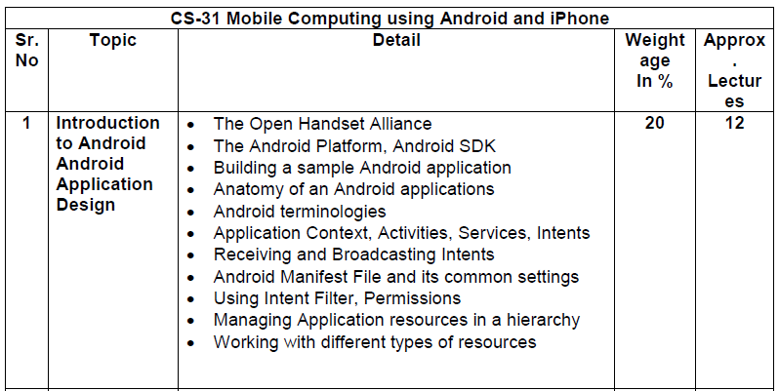

Slide 3
Chapter -1 Introduction to Android
What is Android?
Android is Mobile Operating System based on modified version of the linux kernal and other open source software, designed primarily for touchscreen mobile devices such as smartphones and tablets.
Android Mobile OS developed by Google.
Android Is Open Source.
Android Inc, was founded in Palo Alto, California in October 2003 by Andy Rubin, Rich Miner, Nick sears, and Chris White

Slide 4
Chapter -1 Introduction to Android
In July 2005, Google acquired Android Inc.
On November 5, 2007, the OHA(Open Handset Alliance).
And then initial release September 23, 2008

Slide 5
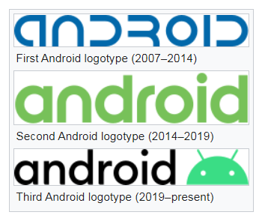
Chapter -1 Introduction to Android

Slide 6
Chapter -1 Introduction to Android
Developer | Google, OHA
Written in | C(Core), C++, Java(UI)
OS Family | Unix like
Working state | Current
Source | Open Source
Initial Release | Sept-23 , 2008
Latest Release | Android 11 - September 8, 2020
Package Manager | Google play , .APK

Slide 7
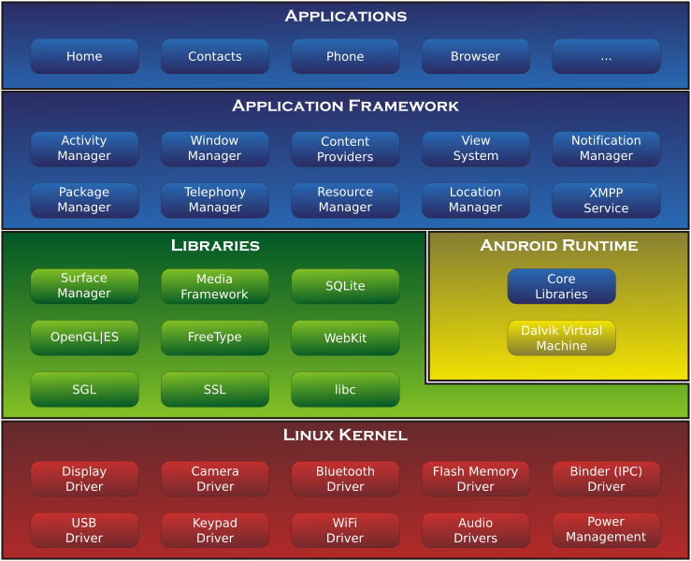
Android-System-Architecture

Slide 8
1.1(The Open Handset Alliance)
The Open Handset Alliance is a group of mobile and technology leaders who share this version for changing the mobile experience for consumers.
The OHA was established on 6 November 2007, led by Google with 47 members including
Mobile Handset makers
Application developers
Mobile carriers and
Chip makers.

Slide 9
1.1 OHA
Mobile Operators
-> T Mobile
-> Softbank
-> Vodafone
Software Companies
-> Google
-> eBay
-> Wind River Systems

Slide 10
1.1 OHA
Semiconductor Companies
-> Audience
-> Intel Corporation
-> Nvidia Corporation
-> Media Tek
Handset Manufactures
-> HTC
-> LG
-> Sony
-> Acer
-> Lenovo

Slide 11
1.2 (The Android Platform)
The Android Platform was launched in 2007 by the Open Handset Alliance, an alliance of famous companies that includes Google, HTC, Motorola and others.
Although most of the applications that run on the Android Platform are written in Java, there is no Java Virtual Machine.
Instead, the Java classes are first compiled into what are known as Dalvik Executable and run on the Dalvik Virtual Machine.

Slide 12
1.2 (The Android Platform) Version List
Pre-commercial release versions
Alpha
-> Release November 2007
Beta
-> Release Nov 5, 2007

Slide 13
1.2 (The Android Platform) Version History By API Level
API Level | Name | Version | Release Date
1 | - | 1.0 | September 23, 2008
2 | - | 1.1 | Feb 9, 2009
3 | Cupcake | 1.5 | April 27, 2009
4 | Donut | 1.6 | Sept 15, 2009
5 | Eclair | 2.0 | Oct 26,2009
6 | Éclair | 2.0.1 | Dec 3,2009
7 | Éclair | 2.1 | Jan 12, 2010
8 | Froyo | 2.2 | May 20, 2010
8 | Froyo | 2.2.1 | Jan 18, 2011
8 | Froyo | 2.2.2 | Jan 22, 2011
8 | Froyo | 2.2.3 | Nov 21, 2011

Slide 14
API Level | Name | Version | Release Date
9 | Gingerbread | 2.3 | Dec 6, 2010
9 | Gingerbread | 2.3.1 | Dec 2010
9 | Gingerbread | 2.3.2 | Jan 2011
10 | Gingerbread | 2.3.3 | Feb 9, 2011
10 | Gingerbread | 2.3.4 | April 28, 2011
10 | Gingerbread | 2.3.5 | July 25, 2011
10 | Gingerbread | 2.3.6 | Sept 2, 2011
10 | Gingerbread | 2.3.7 | Sept 21, 2011
11 | Honeycomb | 3.0 | Feb 22, 2011
12 | Honeycomb | 3.1 | May 10, 2011

Slide 15
API Level | Name | Version | Release Date
13 | Honeycomb | 3.2 | July 15, 2011
13 | Honeycomb | 3.2.1 | Sept 20, 2011
13 | Honeycomb | 3.2.2 | Aug 30, 2011
13 | Honeycomb | 3.2.3 | -
13 | Honeycomb | 3.2.4 | Dec 2011
13 | Honeycomb | 3.2.5 | Jan 2012
13 | Honeycomb | 3.2.6 | Feb 2012
14 | Ice cream Sandwich | 4.0 | Oct 18,2011
14 | Ice cream Sandwich | 4.0.1 | Oct 21, 2011
14 | Ice cream Sandwich | 4.0.2 | Nov 28, 2011
15 | Ice cream Sandwich | 4.0.3 | Dec 16, 2011
15 | Ice cream Sandwich | 4.0.4 | March 29, 2012

Slide 16
API Level | Name | Version | Release Date
16 | Jelly Bean | 4.1 | July 9, 2012
16 | Jelly Bean | 4.1.1 | July 11, 2012
16 | Jelly Bean | 4.1.2 | Oct 9, 2012
17 | Jelly Bean | 4.2 | Nov 13, 2012
17 | Jelly Bean | 4.2.1 | Nov 27, 2012
17 | Jelly Bean | 4.2.2 | Feb 11, 2013
18 | Jelly Bean | 4.3 | July 24, 2013
18 | Jelly Bean | 4.3.1 | Oct 3, 2013
19 | KitKat | 4.4 | Oct 31, 2013
19 | KitKat | 4.4.1 | Dec 5, 2013
19 | KitKat | 4.4.2 | Dec 9, 2013
19 | KitKat | 4.4.3 | June 2, 2014
19 | KitKat | 4.4.4 | June 19, 2014

Slide 17
API Level | Name | Version | Release Date
20 | KitKat | 4.4W | June 25, 2014
20 | KitKat | 4.4W.1 | Sept 6, 2014
20 | KitKat | 4.4W.2 | Oct 21, 2014
21 | Lollipop | 5.0 | Nov 12, 2014
21 | Lollipop | 5.0.1 | Dec 2, 2014
21 | Lollipop | 5.0.2 | Dec 2, 2014
22 | Lollipop | 5.1 | March 9, 2015
22 | Lollipop | 5.1.1 | April 21, 2015
23 | Marshmallow | 6.0-6.0.1 | Oct 5, 2015
24-25 | Nougat | 7.0-7.2 | Aug 22,2016
26-27 | Oreo | 8.0-8.1.0 | Aug 21,2017

Slide 18
API Level | Name | Version | Release Date
28 | Pie | 9 | August 6, 2018
29 | 10 | 10 | September 3, 2019
30 | 11 | 11 | September 8, 2020

Slide 19
1.3 (Android SDK)
The Android Software development kit (SDK) includes a comprehensive set of development tools.
These include a debugger, libraries, a handset emulator based on Quick Emulator, documentation, sample code, and tutorials.
The officially supported integrated development environment (IDE) is Eclipse using the Android Development Tools (ADT) Plugin.

Slide 20
1.3 (Android SDK)
Step to Download and Install Android SDK
Note : You must install java 1.6 or latter in order to work on android
Step to Download
Https://developer.android.com/sdk/index.html
Then click to Download SDK

Slide 21
1.4) Building a sample Android Application
Create your first android application in your Lab.

Slide 22
1.5) Anatomy(Structure) of an Android applications
Src : Java source code files will be available here.
Gen : The gen directory in an Android project contains auto generated files. you can see R.java inside this folder which is a generated class which contains references to certain resources of the project.R.java is automatically created by the Eclipse IDE.
Res : Android supports resources like images and certain XML configuration files , these can be keeping separate from the source code.

Slide 23
1.5) Anatomy(Structure) of an Android applications
/res/values : Used to define strings, colors, dimensions, styles, static arrays etc.
Ex. String are defined in the res/values/string.xml file.
/res/layout : This folder contains the layouts to be used in the application.
/res/menu : This folder contains menu resources to be used in the application.

Slide 24
1.5) Anatomy(Structure) of an Android applications
/res/drawable : Drawable folders are resource directories in the application that provides differrent bitmap drawables for medium, hign and extra high density screens.
/res/drawable-idpi : bitmap for lower density
/res/drawable-mdpi : bitmap for medium density
/res/drawable-hdpi : bitmap for high density
/res/drawable-xhdpi : bitmap for extra high density
/res/drawable-xxhdpi : bitmap for X extra high density

Slide 25
1.5) Anatomy(Structure) of an Android applications
Libs : External library files will be places in this folder.
Assets : This folder contains raw hierarchy of files and directories, with no other capabilities.
Bin : Bin folder is the area used by the compiler to prepare the files to be finally packaged to the application’s APK file.
AndroidManifest.xml : All the android applications will have an AndroidManifest.xml file in the root directory. In short it is a configuration file.
Ic_launcher-web.png : This is an icon to be used in Google play.
512 x 512 pixels

Slide 26
1.5) Anatomy(Structure) of an Android applications
Proguard-project.txt : Everything in the proguard-project.txt file will be used just run ProGuard tool with standard settings.
Project.properties : Is the main project’s properties files containing information such as the build platform target and dependancies.

Slide 27
1.6) Android Terminologies
.apk file : Android application package file.
.dex file : Compiled Android application code file. .dex files can be created by automatically translating comipiled applications written in the java programming language.
Action : An action is a string value assigned to Intent
Ex. Android.intnet.action.VIEW
Activity : A single screen in an application, with supporting java code, derived from the Activity class.
Adb : Android Debug Bridge, a command line debugging application includes with the SDK.

Slide 28
1.6) Android Terminologies
Application : From a component viewpoint, an Android application consists of one or more activities, listeners, and intent receivers
Canvas : Canvas is the simplest, easiest way to draw 2D objects on the screen.
Content Provider : A content provider is built on the ContentProvider class, which handles content query strings of a specific format to return data in a specific format.
Dalvik: The Android Platform’s virtual machine. The Dalvik VM is an interpreter only VM that executes files in the Dalvik Executable (.dex) format, a format that is optimized for efficient storage and memory mappable execution.

Slide 29
1.6) Android Terminologies
DDMS : Dalvik Debug Monitor Service, a GUI debugging application included with the SDK.
Dialog : A dialog can have button controls only and is intended to perform a simple action.
Drawable : A drawable is typically loaded into another UI element , Ex. Background Image.
Intent : It includes several criteria fields that you can supply, activity receives the intent and what the receiver does when handling the intent.
Intent Filter : Through an intent filter, an application can express interest in specific data types, Intent actions etc.

Slide 30
1.6) Android Terminologies
Broadcast Receiver : An application class that listens for intents that are broadcast, rather that being sent to a single target application/activity.
Layout Resources : An XML file that describes that layout of an Activity screen.
Manifest File : An XML file that each application must define, to describe the app’s package name, version, component etc.
Resources : Non programmatic application components that are external to the compiled application code, but which can be loaded from application code.

Slide 31
1.6) Android Terminologies
Service : An object class service that runs in the background to perform action.
Surface : An object of type surface representing a block of memory that get composited to the screen
Surface View : A view object that wraps a surface for drawing and exposes methods to specify its size and format dynamically.
Theme : A set of Properties (Text size, color etc) bundled together to define various default display settings.

Slide 32
1.6) Android Terminologies
View : An object that draws to a rectangular area on the screen and handles click and events.
Viewgroup : A container object that groups is responsible for deciding where child views and representing.
Widget : One of a set of fully implemented view subclasses that render from elements and other UI component.

Slide 33
1.7) Application Context, Activities, Services, Intents
Context : is probably the most used element in android applications.
This is a class whose implementation is provided by the Android system. It allows access to application-specific resources and classes, as well as up-calls for application-level operations such as launching activities, broadcasting and receiving intents, etc
Activities
A single screen in an application, with supporting java code, derieved from activity class.

Slide 34
1.7) Activities
Priority
1)Foreground
2)visible
3)service
4)background
5)Empty
Activity Life cycle
An activity can be in different state which are describe by follow.
Activity State
1)Running
2)Paused
3)Stopped
4)Killed

Slide 35
1.7) Activities
Activity Life cycle methods
1)onCreate()
2)onResume()
3)onPause()
4)onStop()
1)onCreate()
Called when the activity is created , used to initialize activity.
For Ex. Create the user interface.
2)onResume()
Called if the activity gets visible again and the user starts interacting with activity again.
Used to initialize fields , register listeners, bind to service etc.

Slide 36
1.7) Activities
3) onPause()
Called ones another activity gets into the foreground.
Always called before the activity is not visible any more.
For Ex. You unregister listeners, intent receiver, unbind from service or remove system service listeners.
4) onStop()
Called ones activity is no longer visible.
Time or cpu intensive shut down operations.
For Ex. writing information to database shut be down in the on stop methods.

Slide 37
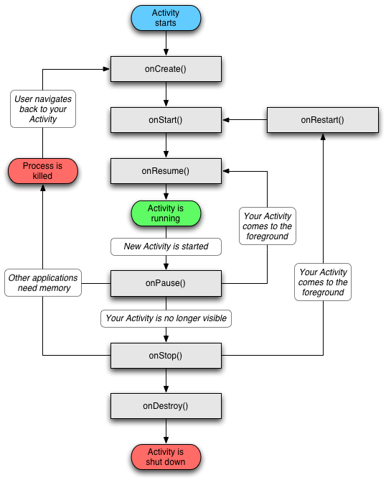
1.7) Activities

Slide 38
1.7) Services
A service is a component that runs in the background to perform long running operations without needing to interact with the user.
For Ex. Play music in the background.
Service State
1) Started
2) Bound
1) Started
A service is started when an application component, such as an activity, starts it by calling startService().
Once started, a service can run in the background indefinite, even if the component that stated it is destroyed.

Slide 39
1.7) Services
2) Bound
A service is bound when an application component binds to it by calling bindService().
A Bound service offers a client server interface that allows components to interact with the service, send request, get results and even do so across processes with interprocess communication.
Callback Method
1)onStartCommand()
The system calls this method when another component, such as an activity, requests that the service be started by calling startService().

Slide 40
1.7) Services
2)OnBind()
The system calls this method when another components wants to bind with the service by calling bindService().
3) onUnbind()
The system calls this method when all clients have disconnected from a particular interface published by the service.
4) onRebind()
The system calls this method when new clients have connected to the service, after it had previously been notified that all had disconnected in its onUnbind(Intent).

Slide 41
1.7) Services
5) onCreate()
The system calls this method when the sevice is first created using onStartCommand() of onBind(). This call is required to perform one time setup.
6) onDestroy()
The system calls this method when the service is no longer used and is being destroyed.

Slide 42
1.7) Intent
Types of Intent
1) Explicit Intent
Specify the component to start by name(class name).
For Example, start a new activity is response to a user action or start a service to download a file in the background.
2) Implicit Intents
Do not name a specific component, but instead declare a general action to perform, which allows a component from another app to handle it.
For Example, If you want to show the user a location on a map, you can use an implicit intent to request that another capable app show a specified location on a app.

Slide 43
1.8) Receiving and broadcasting Intents
A broadcast receiver listens for relevant broadcast messages to trigger an event.
Example :
A camera button was pressed.
The Battery is low.
A new application was installed.
SMS is received.
Screen has turned off.
A broadcast receiver is a class which extends "BroadcastReceiver" and which is registered as a receiver in an Android Application via the AndroidManifest.xml (or via code).
This class will be able to receive intents via the sendBroadcast() method.
"BroadCastReceiver" defines the method "onReceive()".

Slide 44
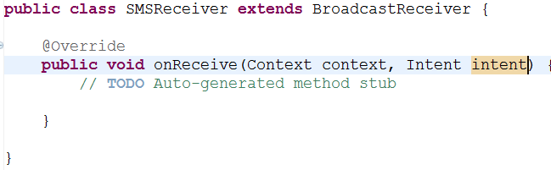
1.8) Receiving and broadcasting Intents
A broadcast receiver is implemented as a subclass of BroadcastReceiver and each
broadcast is delivered as an Intent object. In this case the intent is detected by
android.provider.Telephony.SMS_RECEIVED
To do this we’ll create a class SMSReceiver that extends BroadcastReceiver class and define the method onReceive()

Slide 45
1.9) Android Manifest File and Its Common settings
It is a specially formatted XML File that much accompany each android application.
This file contains important information about the application’s identity.
In this file we can define the
Applications' name
Version information
Permissions and
Other application configurations
Information in this file is used by the android system to
Install and Upgrade the application package.
Display the application details such as the application name, description, and icon to users.
Specify application system requirements including which Android SDKs are supported,
What hardware configuration are required.
Which platform features the application relies upon(Eg. Uses multi touch capabilities).
Launch application activities.
Manage application permissions.

Slide 46
1.9) Android Manifest File and Its Common settings
Eclipse Manifest file resource editor organizes the manifest information into categories :
The Manifest tab
The Application tab
The Permissions tab
The Instrumentation tab
The AndroidManifest.xml tab
Configuring Package-Wide Settings using the Manifest Tab
Its Include the package name.
Version Information.
Supported Android SDK.
Also set any hardware or
or feature requirement.

Slide 47
1.9) Android Manifest File and Its Common settings
Managing Application and Activity Settings using the Application Tab
It’s contains Application label and icon.
Application components such as activities, intent filters and other application components.
Configuration for service, intent filter, and content providers.
Enforcing Application Permissions using the Permissions Tab
A Permission is a restriction limiting access to a part of the code or to data on the device.
The limitation is imposed to protect critical data and code that could be misused to damage the user experience.
Each permission is identified by a unique label.
Eg. :
android.permission.CALL_EMERGENCY_NUMBERS
android.permission.SET_WALLPAPER
android.permission.DEVICE_POWER

Slide 48
1.9) Android Manifest File and Its Common settings
Managing Test Instrumentation using the Instrumentation Tab
It allows the developer to declare any instrumentation classes for monitoring the application.
Instrumentation classes that provide profiling and other information as the application is running.
This declarations are present in manifest only while the application is being developed and tested, they are removed before the application is published.
Editing the Manifest file manually
Android Manifest file is a specially formatted XML file.
We can edit manually by clicking on the AndroidManifest.xml tab.
It’s include a single <manifest> tag with a single <application> tag.
Following is a sample AndroidManifest.xml file.

Slide 49
1.9) Android Manifest File and Its Common settings
AndroidManifest.xml
<?xml version="1.0" encoding="utf-8"?>
<manifest xmlns:android="http://schemas.android.com/apk/res/android"
package="com.android.multimedia"
android:versionCode="1"
android:versionName="1.0">
<application android:icon="@drawable/icon"
android:label="@string/app_name"
android:debuggable="true">
<activity android:name=".MultimediaMenuActivity"
android:label="@string/app_name">
<intent-filter>
<action
android:name="android.intent.action.MAIN" />
<category
android:name="android.intent.category.LAUNCHER" />
</intent-filter>
</activity>

Slide 50
1.9) Android Manifest File and Its Common settings
AndroidManifest.xml
<activity android:name="AudioActivity"></activity>
<activity android:name="StillImageActivity"></activity>
<activity android:name="VideoPlayActivity"></activity>
<activity android:name="VideoRecordActivity"></activity>
</application>
<uses-permission
android:name="android.permission.RECORD_AUDIO" />
<uses-permission
android:name="android.permission.SET_WALLPAPER" />
<uses-permission
android:name="android.permission.CAMERA"></uses-permission>
<uses-sdk
android:minSdkVersion="3"
android:targetSdkVersion="8">
</uses-sdk>
<uses-feature
android:name="android.hardware.camera" />
</manifest>

Slide 51
1.10) Using Intent Filter, Permissions
Android system will determine suitable application for an implicit intent and if several applications exists offer the user the choice to open one.
Intent filters are typically defined via the “AndroidManifest.xml” file.
Implicit intents an application component must register itself via an IntentFilter in the “AndroidManifest.xml” to this event.
Define a permission using the <uses-permission> tag.
Eg.:
<uses-permission android:name=“android.permission.camera”/>
Permission can be enforce at several point :
Starting an Activity or Service
Accessing data provided by a content provider
Sending or receiving broadcasts by an Intent

Slide 52
1.11) Managing Application resources in a hierarchy
Storing Application Resources.
Understanding the Resource Directory Hierarchy.
/res/drawable/
/res/layout/
/res/values/

Slide 53
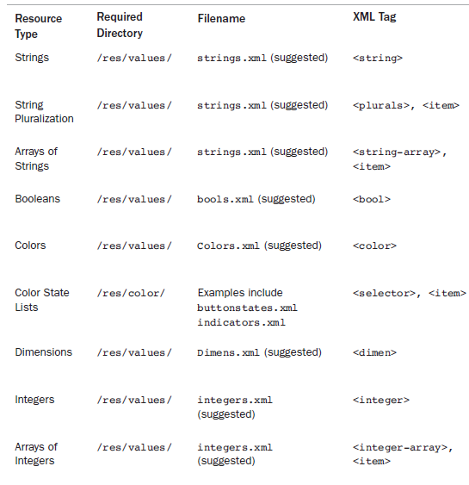
1.11) Managing Application resources in a hierarchy

Slide 54
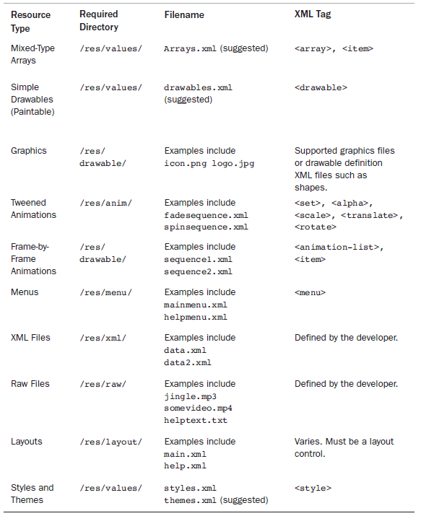
1.11) Managing Application resources in a hierarchy

Slide 55
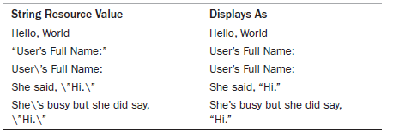
1.12) Working with different types of resources

Slide 56
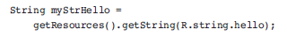
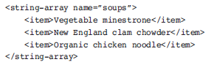
1.12) Working with different types of resources
Using string resources as Format String.
Using string resources programmatically.
Working with string array.

Slide 57
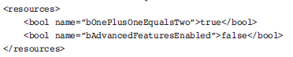
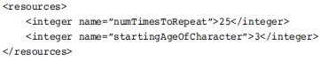
1.12) Working with different types of resources
Working with Boolean Resources.
Working with Integer Resources.

Slide 58
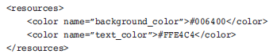
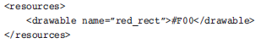
1.12) Working with different types of resources
Working with colors

Slide 59
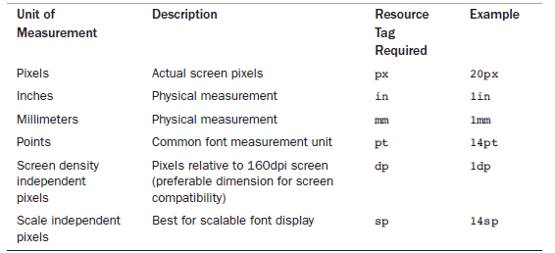
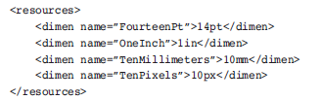
1.12) Working with different types of resources
Working with dimensions

Slide 60
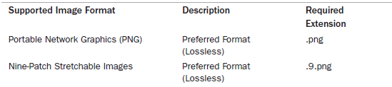

1.12) Working with different types of resources
Working with Images

Slide 61
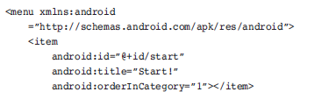
1.12) Working with different types of resources
Working with Animation.
Defining and using frame by frame Animation Resources.
Defining and using tweened Animation resources.
Working with Menus.

Slide 62
1.12) Working with different types of resources
Working with XML Files.
Working with Raw Files.
Working with Layouts.
Working with Styles.
References System Resources.

